Slide 1

Founder: CJ Miller
Members: Jeremy Brinegar
Max Morgan
Ishank Tandon
Notes:
CJ
0-15

Slide 2
What is MineService?
Scalable Minecraft Server Administration tools
Save time
Fast Information
All in one spot
Notes:
Ishank
15-1:00

Slide 3
Demo
Notes:
CJ
1:00 – 4:00

Slide 4
Usability demographics
9 total participants
8 men, 9 women
7 beginners, 2 intermediate users
Notes:
Jeremy
4:00 -

Slide 5
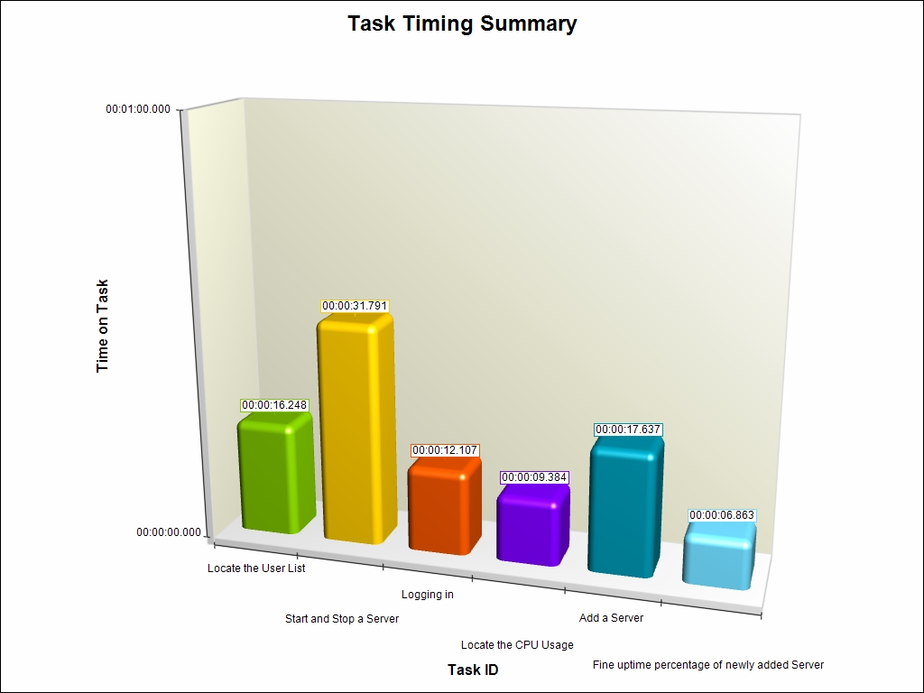
Usability testing summary
Starting/Stopping a server was by far the most time taken
Either found it quickly, or took forever
Highly used feature should not take over 30 seconds

Slide 6
Usability Changes
We decided on making a “Servers” heading
Other changes were thought about, none made

Slide 7
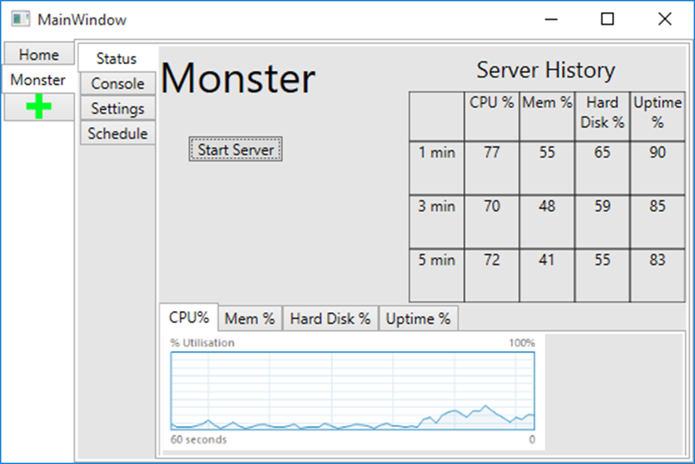
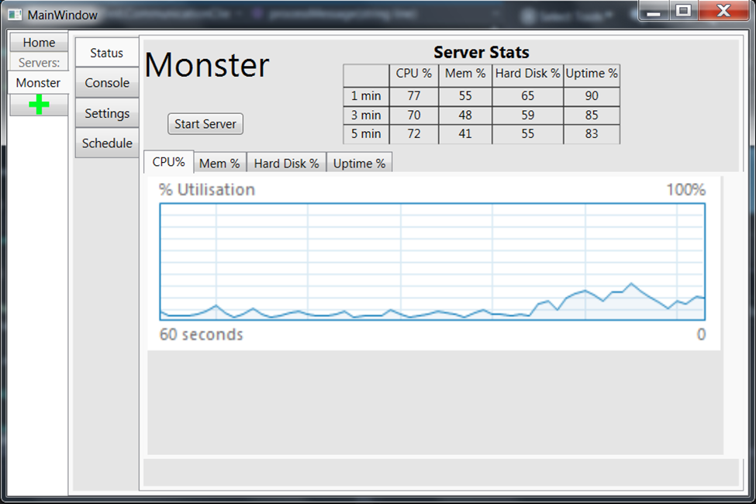
“Servers” heading
Notes:
7:00

Slide 8
Status
Completed all features we assigned on our Taiga Board except TCP encryption.
Many more features left for final product.
FTP
User/Group Permissions
CPU/Memory Usage
Automatic Server Restart
Ability to send commands via e-mail or text message
Notes:
Max
7:00 – 8:00

Slide 9
Business Model
Advertisement
Forums and IRC for Minecraft Server Admins
MineCon
Revenue
Sell per version / feature
Installation / Setup services
Notes:
Max
8:00 – 9:00

Slide 10
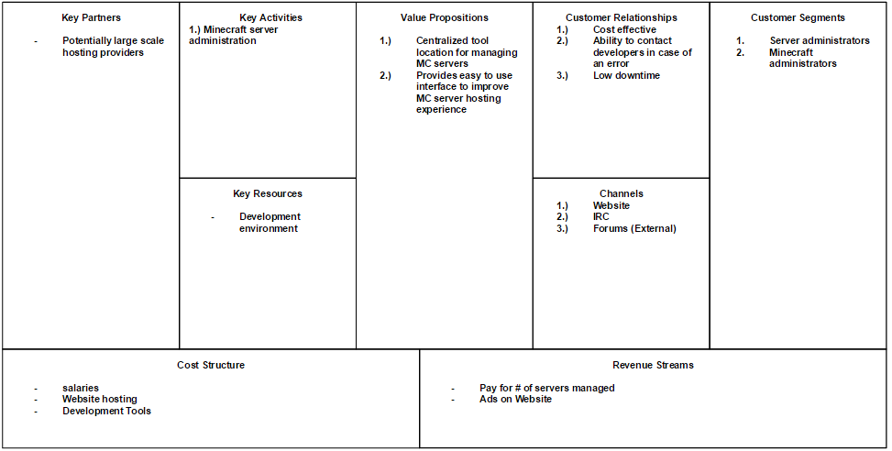
BMC
Notes:
Max
8:00 – 9:00

Slide 11
Lessons Learned
Communication is very important
Team and Client
Design the application with the end user in mind
Personas / User Stories
Minimum Viable Product for user feedback
Experience with New Technology
Notes:
Ishank
9:00 – 10:00

Slide 12
Do Differently
Scale back our MVP
Make more modular
Notes:
Ishank
9:00 – 10:00

Slide 13
Questions?

